Slide 1
Focal Presentation:
Newport Bay Water Quality
Matthew L. Walsh

Slide 2
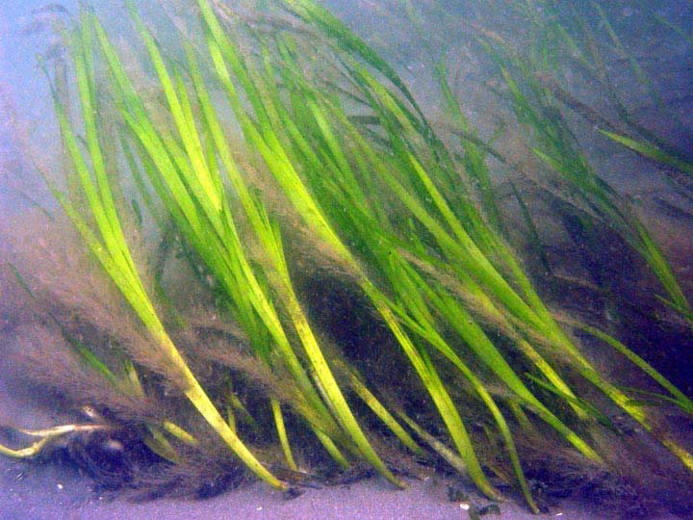
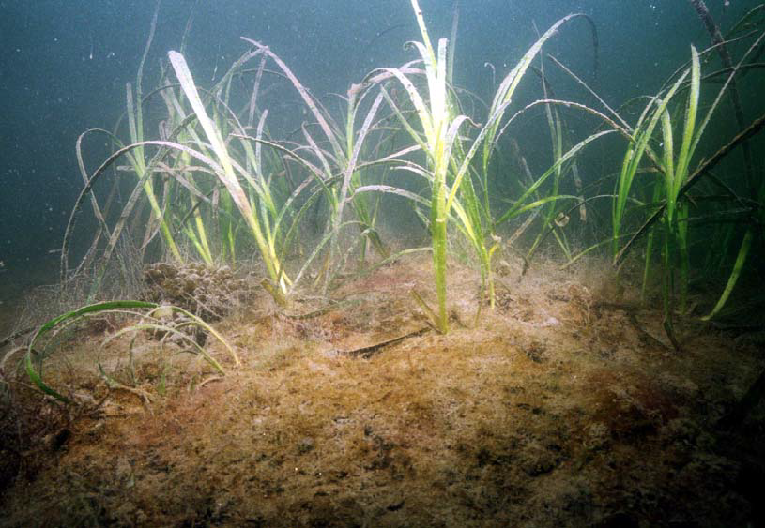
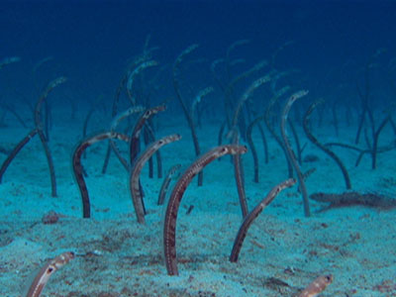
Eelgrass
Image source
First Newport Bay Eelgrass Mapping Survey (2005)
Image source
First Newport Bay Eelgrass Mapping Survey (2005)
PBS Nature S23 EP2

Slide 3
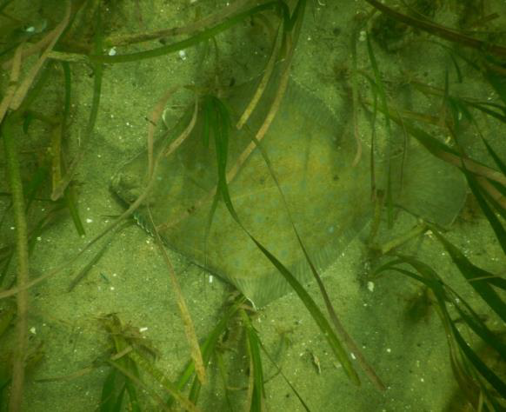
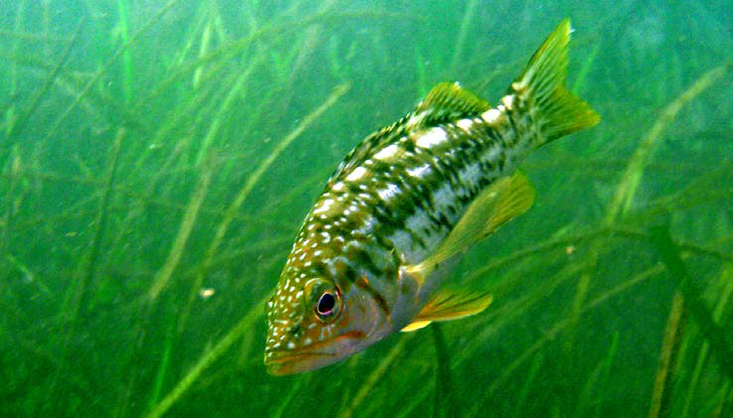
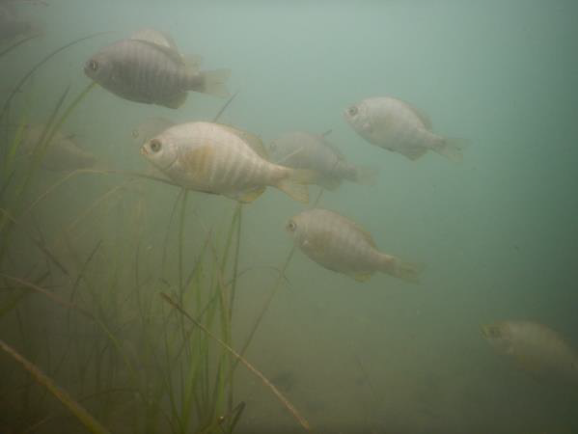
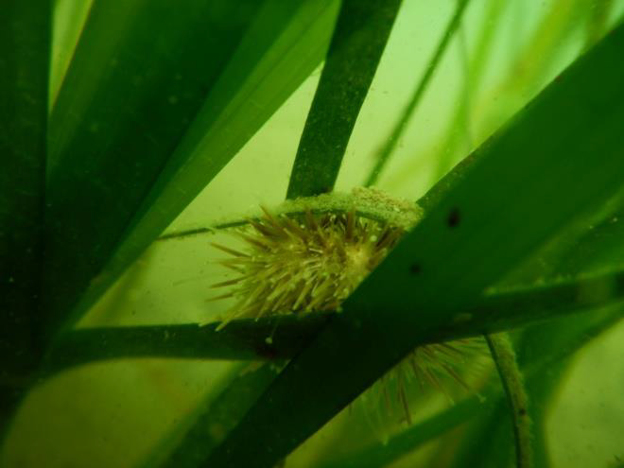
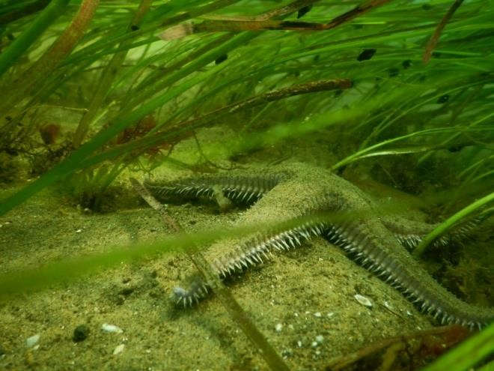
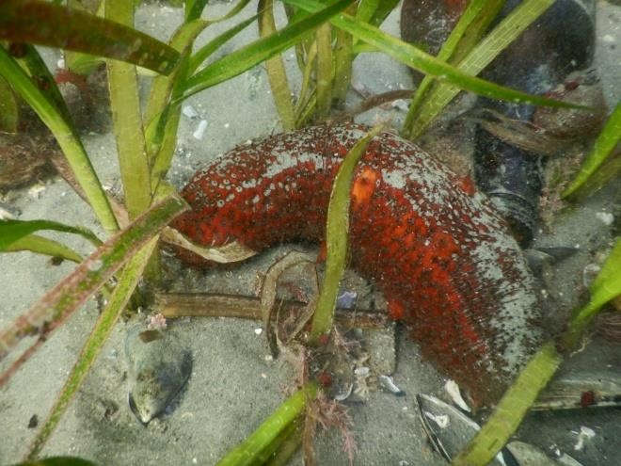
Critical Habitat Role
Image Source
Fifth Newport Bay Eelgrass Mapping Survey (2016)
Sixth Newport Bay Eelgrass Mapping Survey (2018)
ii.
i.
ii.
ii.
ii.
ii.

Slide 4
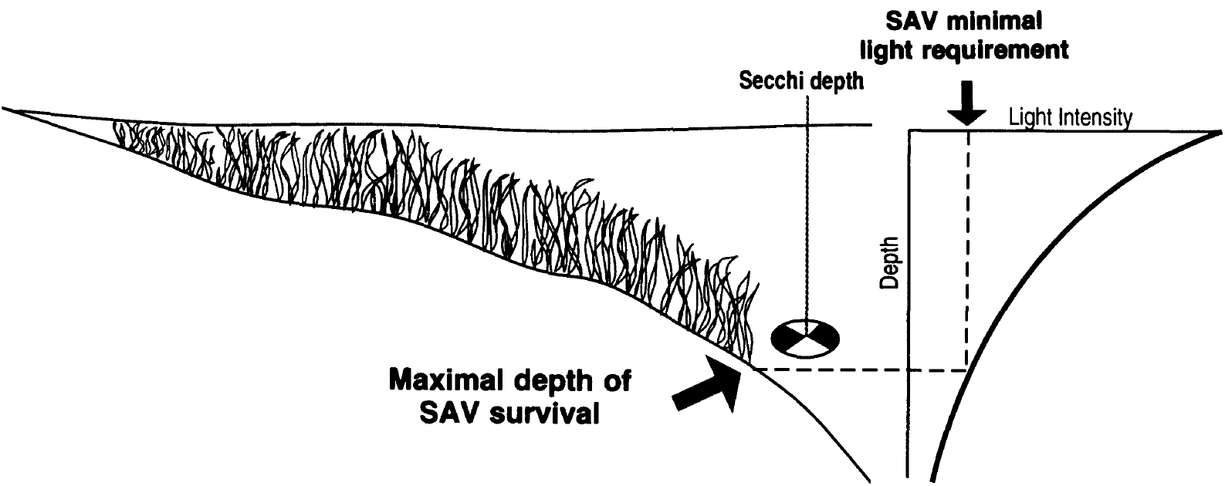
Light Limited Growth
Image source
Dennison et al. (1993). Assessing Water Quality with Submersed Aquatic Vegetation.

Slide 5

Project Outline

Slide 6
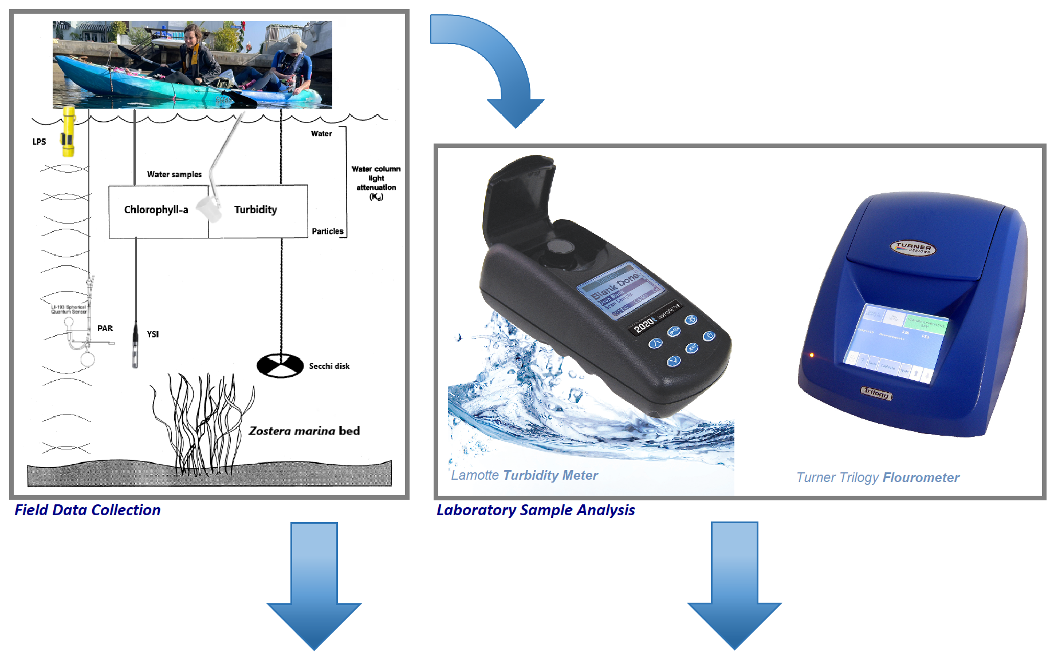

Slide 7
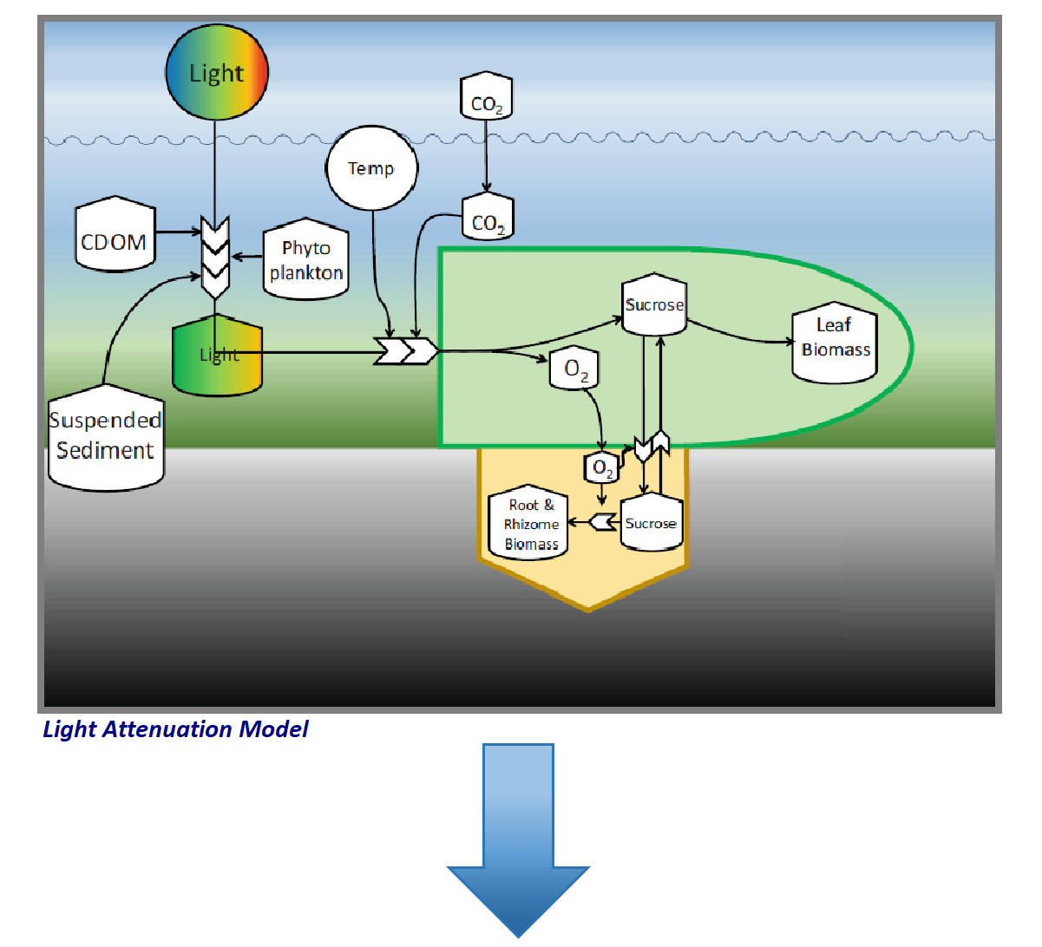

Slide 8
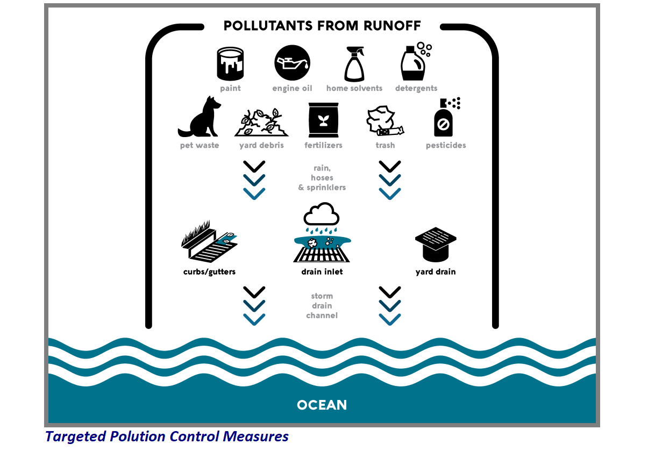

Slide 9
Is there an association between light availability and eelgrass bed stability across sample sites?
Randomized Block ANOVA

Slide 10
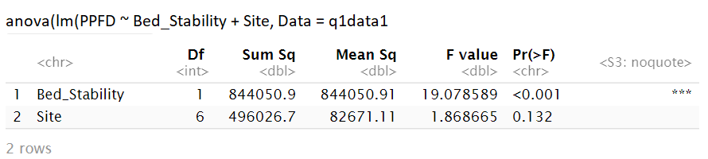
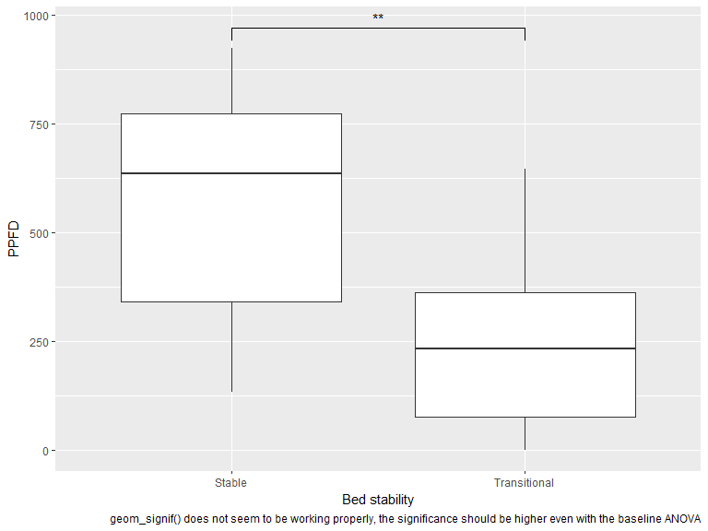
Notes:
ANOVA showed there was a significant effect of bed stability on PPFD f_{1,6}=19.08, p-val < 0.001

Slide 11
What environmental variables are significant predicters of bed stability across within lower Newport Bay?
Multiple Logistic Regression

Slide 12
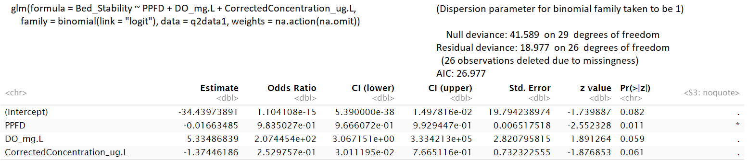
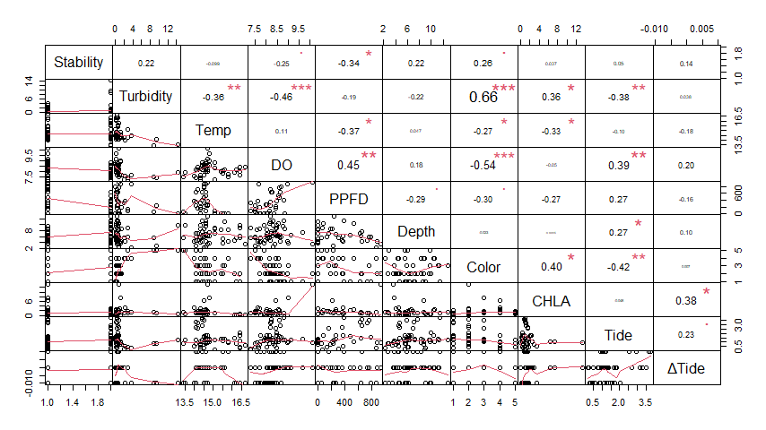
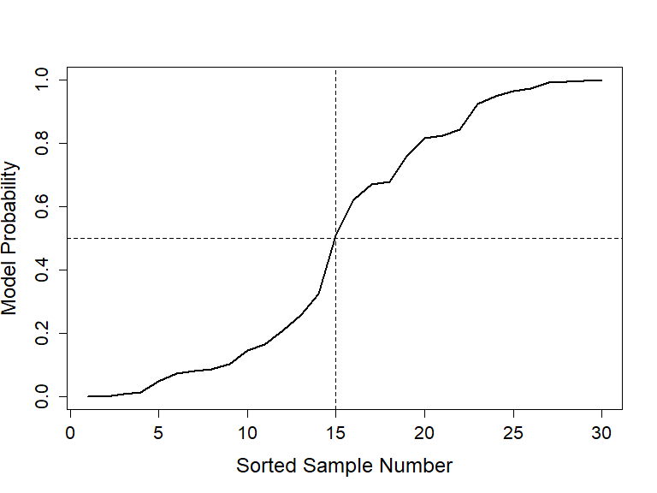
Notes:
PPFD significantly predicted bed stability, with more minor improvements to the logistic regression model by adding Dissolved Oxygen (mg/L) and corrected concentration of CHLA (µg/L)

Slide 13
Is Chlorophyll-a concentration a significant predictor of light availability?
Linear Regression

Slide 14
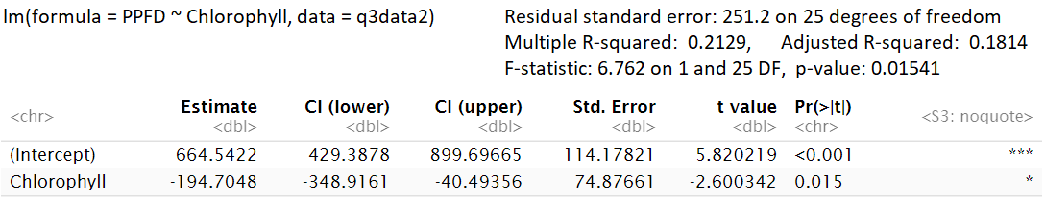
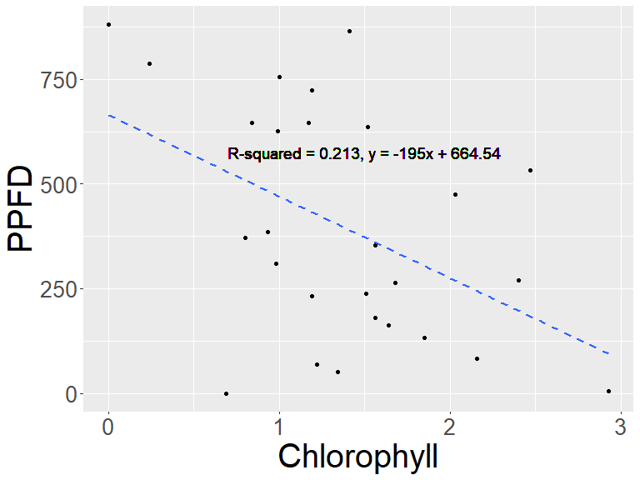
Notes:
CHLA was a significant predictor of PPFD

Slide 15
MFA() function usage [FactoMineR] type ?FactoMineR::MFA into console for more info
• base : a data frame with n rows (individuals) and p columns (variables)
• group: a vector with the number of variables in each group.
• type: the type of variables in each group. By default, all variables are quantitative and scaled to unit variance. Allowed values include:
○ “c” or “s” for quantitative variables. If “s”, the variables are scaled to unit variance.
○ “n” for categorical variables.
○ “f” for frequencies (from a contingency tables).
• ind.sup: a vector indicating the indexes of the supplementary individuals.
• name.group: a vector containing the name of the groups (by default, NULL and the group are named group.1, group.2 and so on).
• num.group.sup: the indexes of the illustrative groups (by default, NULL and no group are illustrative).
• graph : a logical value. If TRUE a graph is displayed.

Slide 16
MFA Design
Sample Site Constants | Sampling Conditions | OAC indicators | PPFD
Site Bed Stability | Date & Time Temp_C DO_mg.L DO_% BottomDepth_ft PredictedTide TideChange | Turbidity_NTU ForelUleColorCategory CalculatedConcentration_µg/L | PPFD
res.mfa <- MFA(data,
group = c(2, 7, 3, 1), # specifies size of groups
type = c("n", "s", "s", "s"), # specifies group data type, 's' creates standardized as opposed to basic quantitative variables and is important if quantitative variables use different units.
name.group = c("Sample Site Constants", "Sampling Conditions", "OAC Indicators", "PPFD"), # assigns names for groupings
num.group.sup = c(1, 4), # specifies which groups are supplementary
graph = FALSE # binary deciding if a graph is produced
)

Slide 17
Key Statistics of the Multiple Factorial Analysis
MFA variable | Group | Dim.1 | Dim.2 | Dim.3 | Dim.4 | Dim.5
Coordinates | Sampling Conditions | 0.8836081 | 0.2491804 | 0.2918705 | 0.25980476 | 0.2008872
 | OAC Indicators | 0.8936717 | 0.5260442 | 0.1275075 | 0.06392842 | 0.0372208
Cos2, quality of representation | Sampling Conditions | 0.5950918 | 0.04732518 | 0.06492996 | 0.051446847 | 0.030758768
 | OAC Indicators | 0.5844510 | 0.20250532 | 0.01189771 | 0.002990749 | 0.001013826
Contributions | Sampling Conditions | 49.71688 | 32.14299 | 69.59605 | 80.25274 | 84.3681
 | OAC Indicators | 50.28312 | 67.85701 | 30.40395 | 19.74726 | 15.6319

Slide 18
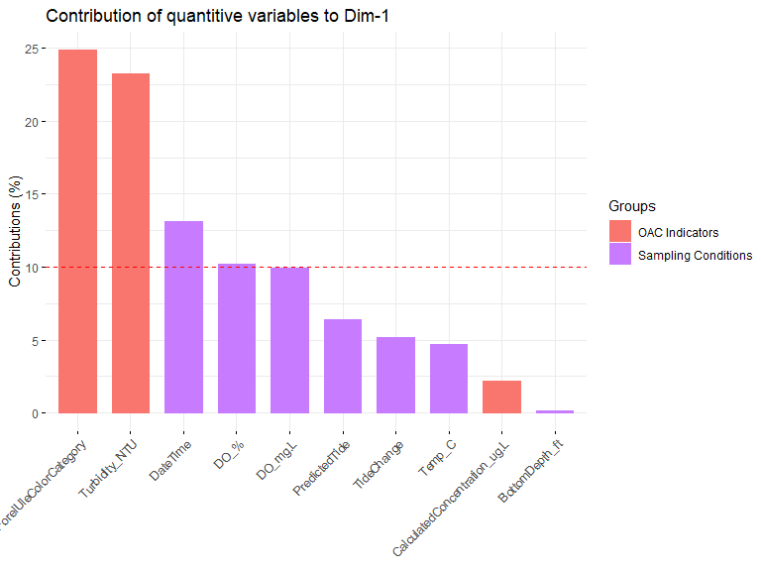
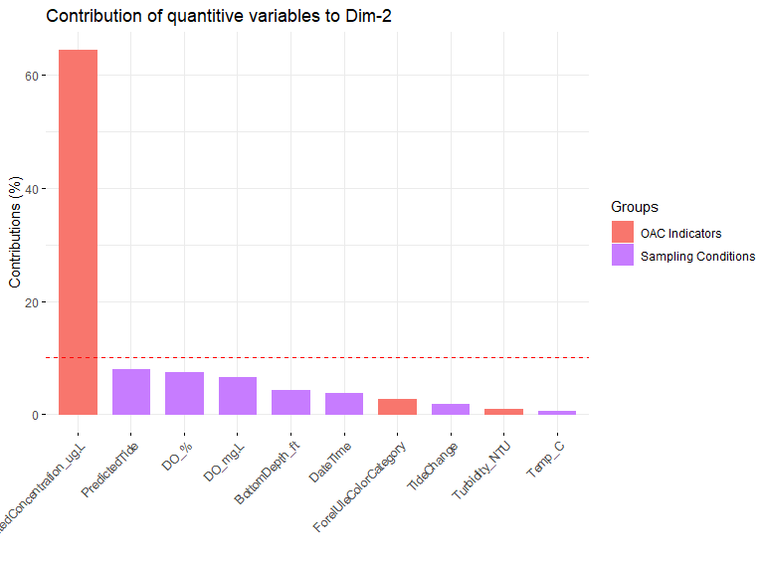
Contribution of variables to MFA dimension definition
Notes:
Those variables contributing the most to

Slide 19
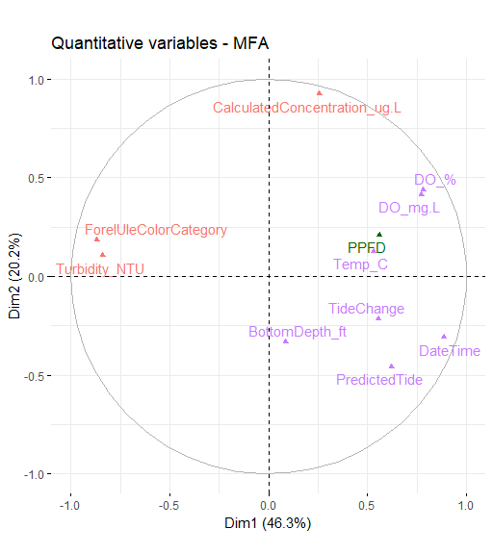
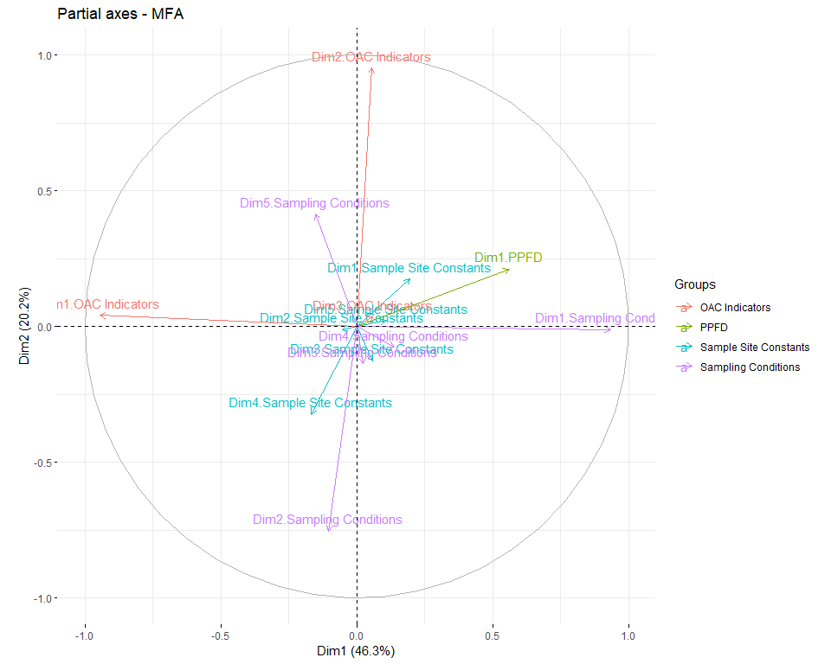
MFA graphs

Slide 20
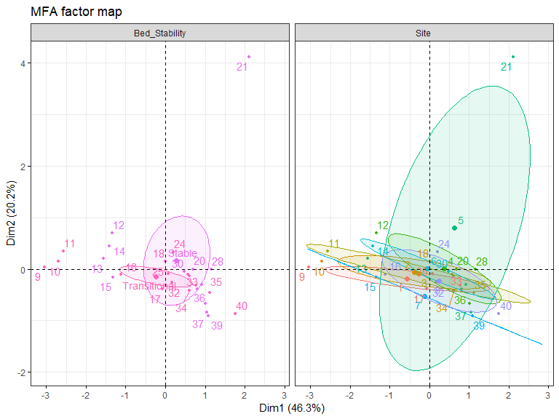
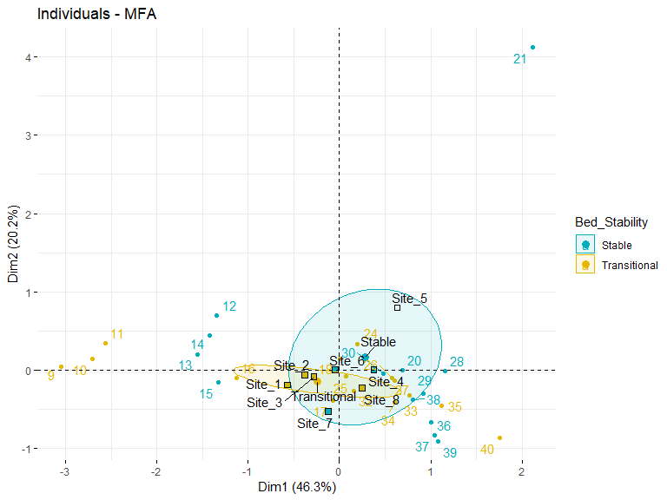

Slide 21
And Now for something more useful
Open ggplot2_axis-label-tricks_MWalsh.rmd

Slide 22

Thank you to my team and audience!
Hayden C. Franciscus
Dana M. Briggs
Amy K. Henry
Anna Jullie

